Slide 1
Apache Spark

Slide 2
Introduction
Apache Spark is an open-source fast-growing and general-purpose cluster computing tool.
It provides a reach set of APIs in Java, Scala, Python and R as well as spark engine that supports general execution.
It supports higher-level tools like Spark SQL, Mllib, GraphX and Spark Streaming.
100 times faster compared to the Hadoop MapReduce framework.

Slide 3
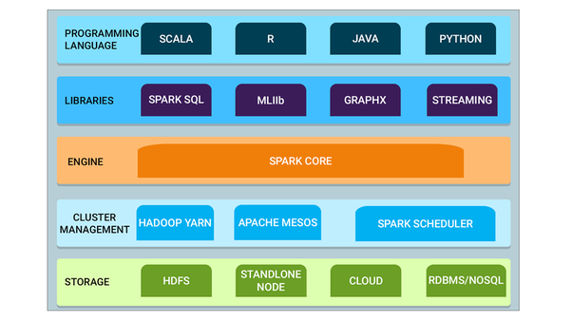
Apache Spark Ecosystem
Fig. Spark Ecosystem Components

Slide 4
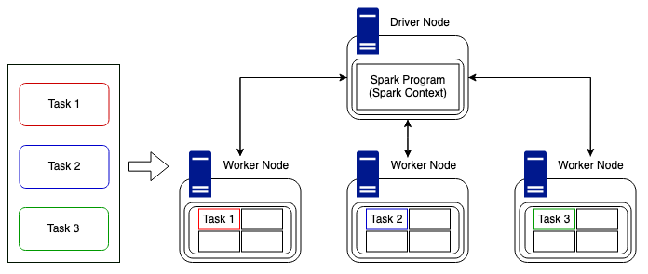
Spark Architecture
Fig. Spark Architecture – RDD AND DAG

Slide 5
Features
In memory computation
Speed
Fault Tolerance
Real Time Stream Processing
Multiple language support
Lazy Evaluation

Slide 6
RDD
Apache Spark RDD stands for “Resilient Distributed Dataset”, which is the fundamental structure and building blocks of any Spark application.
RDD is immutable and follows transformations and actions.
Each dataset in RDD is logically partitioned and spread across multiple nodes.
It can automatically rebuild in case of node failure.
Resilient:-It represents a fault-tolerance feature which means in case of node failure it can rebuild data.
Distributed:-It represents the distribution of data across multiple nodes.
Dataset:-It represents the type of data like CSV file, text, and JSON file which can be loaded for processing.

Slide 7
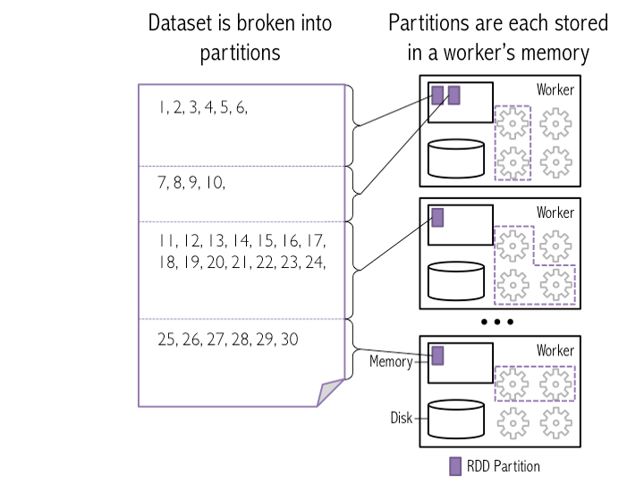
Partition in RDD
The Partitions are the parts of RDD that allow Spark to execute in parallel on a cluster of nodes

Slide 8
RDD Creation
Parallelizing Collection
We can call SparkContext parallelize method on an existing collection in the driver program.
Example:
scala>val sub1 = sc.parallelize(List("cab","abc","mnu","mnu","edu","com"))
scala>val sub2 = sc.parallelize(List("cab","mnu","abc"))
scala>val output = sub1.subtract(sub2)
scala>output.foreach{println}
Output: edu , com

Slide 9
Contd….
2. Referencing External Dataset
Spark RDD can be created from any data source supported by Hadoop such as HDFS, local file system, Cassandra, Amazon S3, Hbase etc.
The supported files format for Apache Spark is SequenceFile, textfile, Hadoop InputFormat, and so on.
Example : data.text = 1,,2,3,4,5,6,7,8,9,10
scala>val text_file = sc.textFile("data.text")
scala>text_file.map(s => s.length).reduce((a, b) => a + b)
Output: 20

Slide 10
Contd…
3. Creating RDD By Referring Already Exist RDD
An RDD can be created by performing a transformation on an existing RDD in which a new RDD will be created without affecting the existing RDD as RDD are immutable.
Example
scala>val textFile=spark.sparkContext.parallelize(Seq(("Spark", 200), ("Scala", 300), ("Java", 400),("Python", 500)))
scala>textFile.foreach(println)
scala>val textFile1 = textFile.map(row=>{(row._1,row._2-50)})
scala>textFile1.foreach(println)
Output: (Spark, 150) (Scala, 250) (Java, 350) (Python, 450)

Slide 11
RDD Operations
Transformations
It creates new RDD from existing RDD by applying functions like Map, Filter FlatMap etc
All transformations in Spark are lazy in nature which means they do computation only when an action is called on the dataset and add execution of transformation in DAG (Directed Acyclic Graph).
Actions
Actions will return a value to the driver program after running a computation on the dataset as we know transformations are lazy in nature
It is a process to send data from executors to the driver. Collect(), count(), first (), saveAsTextFile(path) are some of the actions in Spark.

Slide 12
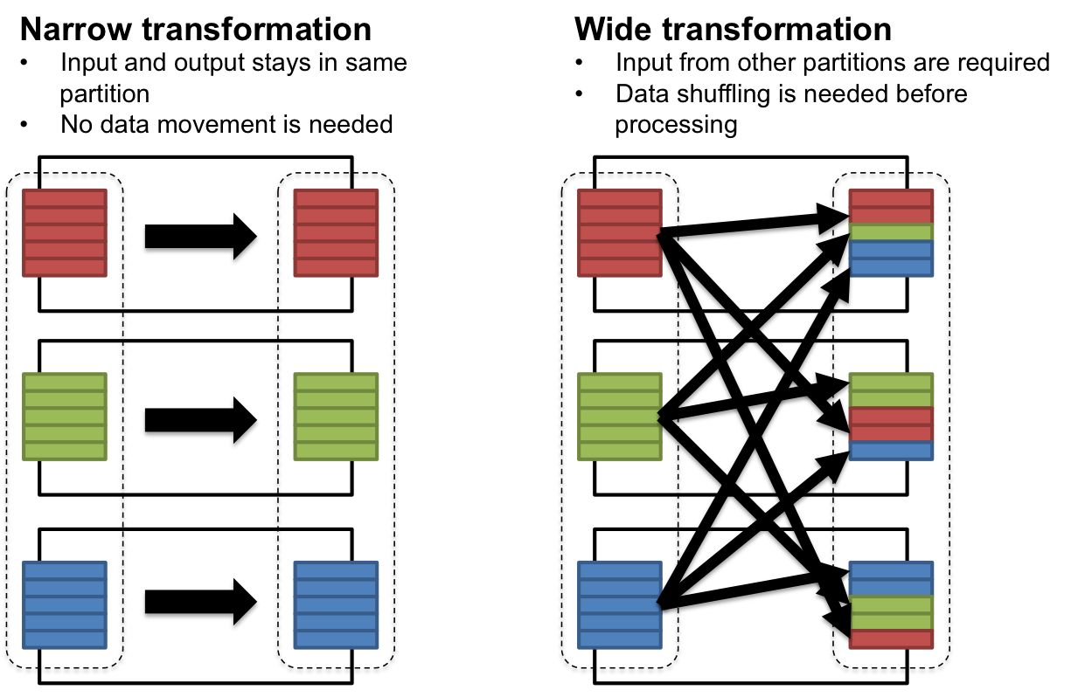
Types of Transformation

Slide 13
Contd…
Filter
Map
flatMap
groupByKey
reduceByKey
sortByKey
aggregateByKey
union
join
distinct
mapPartitions

Slide 14
Map()
scala>val x = sc.parallelize(Array("b", "a", "c","d","e"))
scala>println(x.collect().mkString(", "))
Output: b, a, c, d, e
scala>val y = x.map(z => (z,1))
scala>println(y.collect().mkString(", "))
Output: (b,1), (a,1), (c,1), (d,1), (e,1)

Slide 15
Filter()
scala>val x = sc.parallelize(Array(1,2,3,4,5,6,7,8,9,10))
scala>println(x.collect().mkString(", "))
Output: 1,2,3,4,5,6,7,8,9,10
scala>val y = x.filter(n => n%2 == 1)
scala>println(y.collect().mkString(", "))
Output: 1, 3, 5, 7, 9

Slide 16
flatMap()
scala>val x = sc.parallelize(Array(1,2,3,4,5,6,7,8,9,10))
scala>println(x.collect().mkString(", "))
Output: 1,2,3,4,5,6,7,8,9,10
scala>val y = x.flatMap(n => Array(n, n*100, 42))
scala>println(y.collect().mkString(", "))
Output: 1, 100, 42, 2, 200, 42, 3, 300, 42, 4, 400, 42, 5, 500,42 ….

Slide 17
groupByKey()
scala>val x = sc.parallelize( Array("Spark", "Hadoop", "Hive", "Scala"))
scala>val y = x.groupBy(w => w.charAt(0))
scala>println(y.collect().mkString(", "))
Output:
(S, compactBuffer(Spark,Scala)) ,
(H, compactBuffer(Hadoop, Hive))

Slide 18
mapPartitions()
scala>val x = sc.parallelize(Array(1,2,3,4,5,6,7,8,9,10), 2)
scala>def f(i:Iterator[Int])={ (i.sum,42).productIterator }
scala>val y = x.mapPartitions(f)
// glom() flattens elements on the same partition
scala>val xOut = x.glom().collect()
Output: Array(Array(1,2,3,4,5), Array(6,7,8,9,10))
scala>val yOut = y.glom().collect()
Output: Array(Array(15,42), Array(40,42))

Slide 19
mapPartitionsWithIndex()
scala>val x = sc.parallelize(Array(1,2,3,4,5,6,7,8,9,10), 2)
scala>def f(partitionIndex:Int, i:Iterator[Int]) = { (partitionIndex, i.sum).productIterator }
scala>val y = x.mapPartitionsWithIndex (f)
// glom() flattens elements on the same partition
scala>val xOut = x.glom().collect()
Output: Array(Array(1,,2,3,4,5), Array(6,7,8,9,10))
scala>val yOut = y.glom().collect()
Output: Array(Array(0, 15), Array(1, 40))

Slide 20
Union()
scala>val x = sc.parallelize(Array(1,2,3,4,5), 2)
scala>val y = sc.parallelize(Array(3,4), 1)
scala>val z = x.union(y)
scala>val zOut = z.glom().collect()
Output: Array(Array(1, 2) , Array(3, 4, 5), Array(3, 4))

Slide 21
Join()
scala>val x = sc.parallelize(Array(("a", 1), ("b", 2)))
scala>val y = sc.parallelize(Array(("a", 3), ("a", 4), ("b", 5)))
scala>val z = x.join(y)
scala>println(z.collect().mkString(", "))
Output: (a, (1,3) ), ((a, (1,4)) ,( b,(2,5))

Slide 22
distinct()
scala>val x = sc.parallelize(Array(1,2,3,3,4,4,4,4,5,5,5,6,7,7,8,8,8,9,9,9))
scala>val y = x.distinct()
scala>println(y.collect().mkString(", "))
Output: 1, 2, 3, 4, 5, 6, 7, 8, 9

Slide 23
Actions Operations
Map
Reduce
Foreach
Filter
Count
firstRecords

Slide 24
Getnumpartitions()
scala>val x = sc.parallelize(Array(1,2,3,4,5,6,7), 2)
scala>val y = x.partitions.size
Output: 2
scala>val xOut = x.glom().collect()
Output: Array(Array(1,2,3), Array(4,5,6,7))
scala>println(y)
Output: 2

Slide 25
Reduce()
scala>val x = sc.parallelize(Array(1,2,3,4,5,6,7,8,9))
scala>val y = x.reduce((a,b) => a+b)
Output: y : Int = 45
scala>println(x.collect.mkString(", "))
Output: 1,2,3,4,5,6,7,8,9
scala>println(y)
Output: 45

Slide 26
MAX()
scala>val x = sc.parallelize(Array(2,4,1,5,10,1))
scala>val y = x.max
Output: y : Int = 10
scala>println(x.collect.mkString(", "))
Output: 2,4,1,5,10,1
scala>println(y)
Output: 10

Slide 27
sum()
scala>val x = sc.parallelize(Array(2,4,1,5,10,1))
scala>val y = x.sum
Output: y : Int = 23
scala>println(x.collect.mkString(", "))
Output: 2,4,1,5,10,1
scala>println(y)
Output: 23

Slide 28
Mean()
scala>val x = sc.parallelize(Array(2,4,1,5,10,1))
scala>val y = x.mean
Output: y : Double = 3.833333333
scala>println(x.collect.mkString(", "))
Output: 2,4,1,5,10,1
scala>println(y)
Output: 3.833333333

Slide 29
CountByKey
scala>val x = sc.parallelize(Array(('J',"Jony"),('F',"Friend"), ('A',"Apple"),('J',"Joker")))
scala>val y = x.countByKey()
scala>println(y)
Output: Map( A→1, J→2, F→ 1)

Slide 30
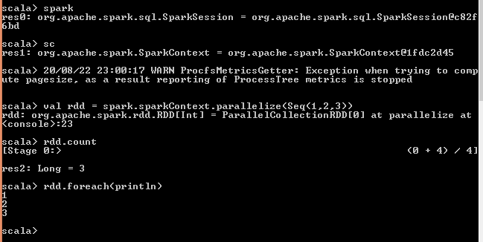
Example

